Slide 2
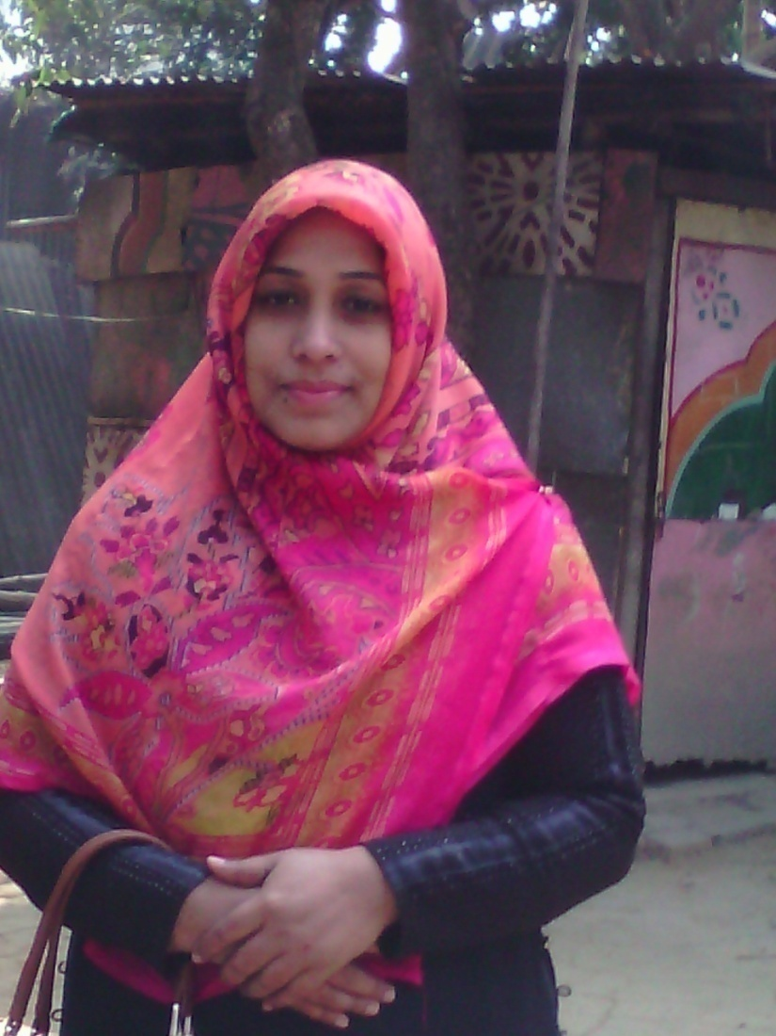
IDENTITY OF PRESENTER
Azmeri Akhter
Assistant teacher (English),
MPO INDEX 2113657
Bishwa Zaker Manjil Alia Madrasah
E-mail-azmery1985@gmail.com
Air-Contact- 01719679134
UNIT-03
LESSON-03
DATE-06.03.17

Slide 3
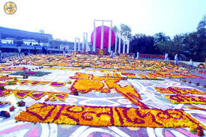
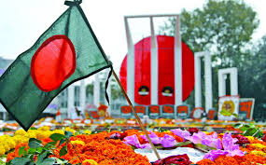
Warming Up

Slide 4
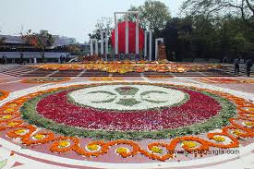

Slide 5
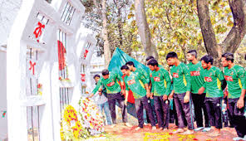
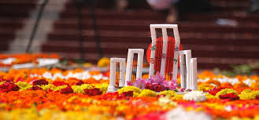

Slide 6
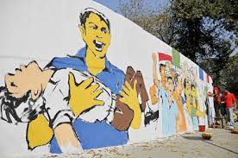
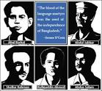
Today’s Lesson
21 February

Slide 7
Learning Outcomes
After reading this lesson the student’s will have learned –
1.To describe Language Movement of Bangladesh.
2.To know about martyr’s of Language Movement.
3.To know about contribute the student ‘s of Dhaka University.

Slide 8
Tha Martyr’s of Language
Movement-1952

Slide 9
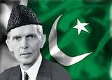
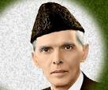
Mohammah Ali Zinnah,Governor
General of Pakistan

Slide 10
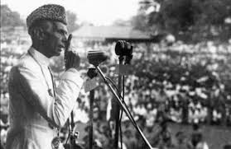
The Declaration of
Mohammad Ali Zinnah

Slide 11
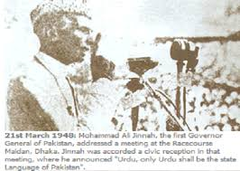
“Urdu would be the only state
Language of Pakistan……….”

Slide 12
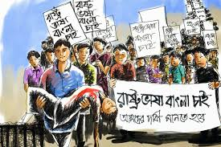
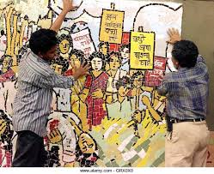
The declaration raised a storm of protest in the eastern part of the country.

Slide 13
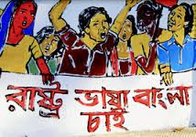
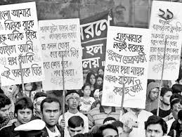
The students of Dhaka University defied the law and the brought out a peaceful protest processiob on 21 February-1952

Slide 14
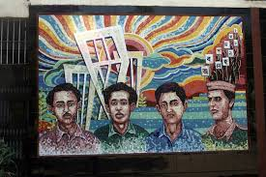
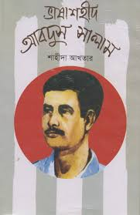
When the procession reached near Dhaka Medical College,the police opened fire on the students,killing Salam,Rafiq,Barkat,Safiur and Jabbar.

Slide 15
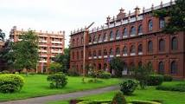
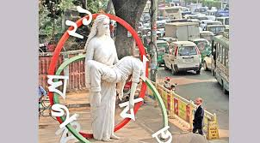
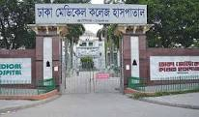

Slide 16
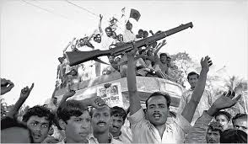
As a result there were mass protest as all over the country and the government had to declare Bengali too as a state language.

Slide 17
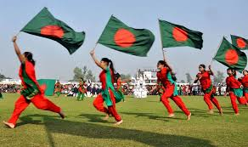
This kindled the sparks of Independence Movement of Bangladesh

Slide 18
Individual work
1.Why do we observe 21 February as the International Mother Language Day?
2.What was the result of the language movement?
3.What was the effect of Mr.Zinnah’s speech?

Slide 19
Pair work
What do you want regarding Mohammad Ali Zinnah?

Slide 20
GROUP WORK
“The seed of Independence was sown in 21 February,1952”.Do you agree with the comment?Why?

Slide 21
HOME WORKS
Write summarize the above passage.

Slide 22
All Student”S

